Slide 1
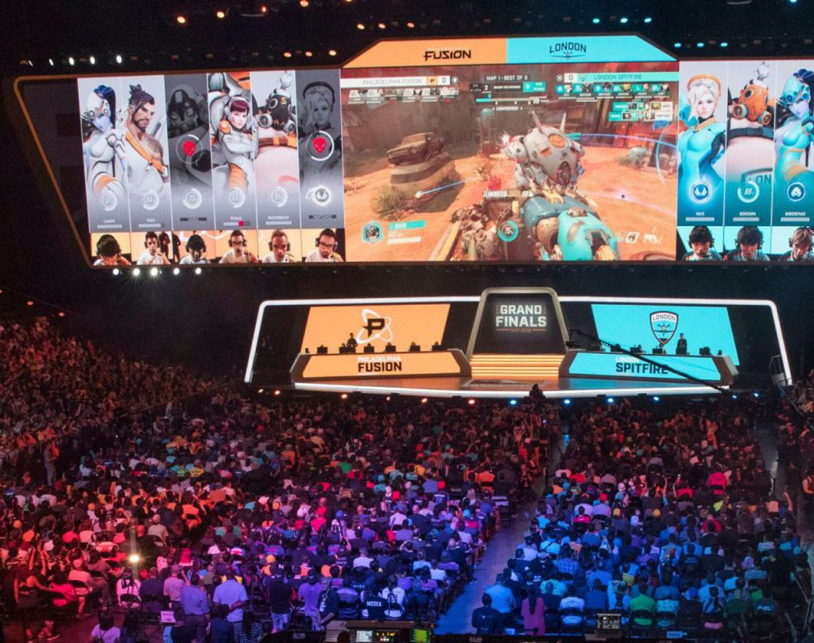
Esports Tournament
This Photo by Unknown Author is licensed under CC BY

Slide 2

Introduction
The top eSports competitors from across the globe have gathered to battle it out Can you analyse the following data to find out all about the tournament?
This Photo by Unknown Author is licensed under CC BY-SA-NC

Slide 3


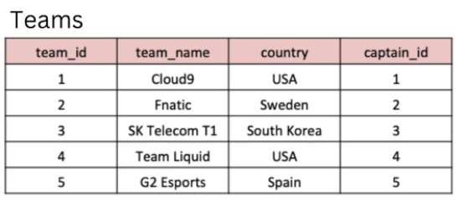
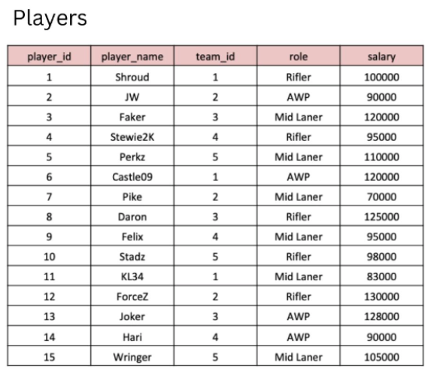

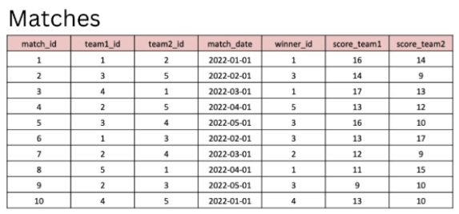


Tables
This Photo by Unknown Author is licensed under CC BY-SA
This Photo by Unknown Author is licensed under CC BY-SA
This Photo by Unknown Author is licensed under CC BY-SA-NC
This Photo by Unknown Author is licensed under CC BY-SA

Slide 4
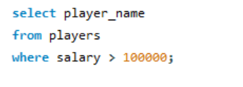
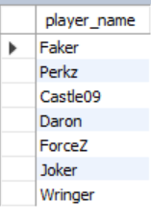
1. What are the names of the players whose salary is greater than 100,000?

Slide 5

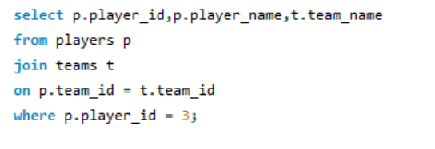
2. What is the team name of the player with player_id = 3?

Slide 6
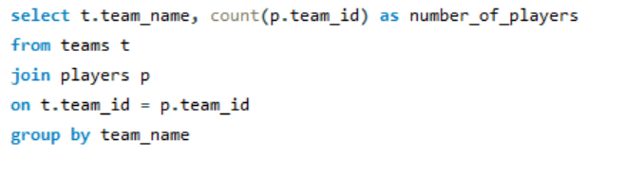
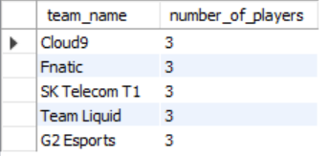
3. What is the total number of players in each team?

Slide 7

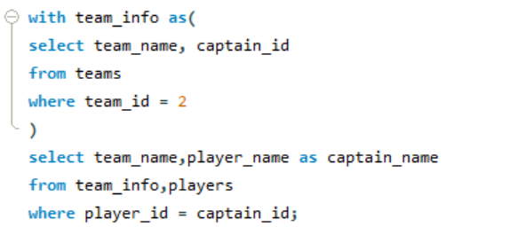
4. What is the team name and captain name of the team with team_id = 2?

Slide 8
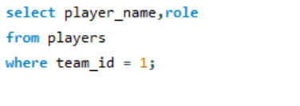
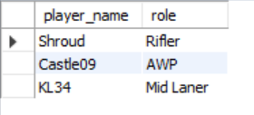
5. What are the player names and their roles in the team with team_id = 1?

Slide 9
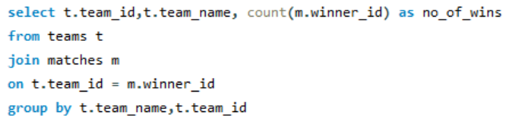
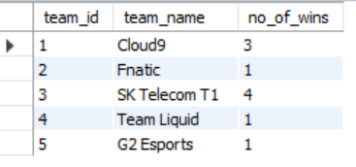
6. What are the team names and the number of matches they have won?

Slide 10
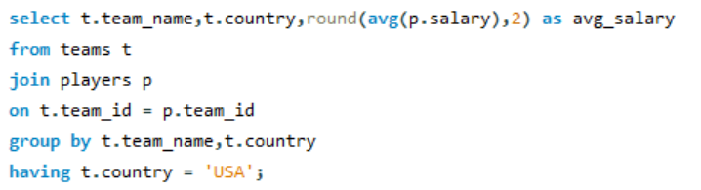

7. What is the average salary of players in the teams with country 'USA'?

Slide 11
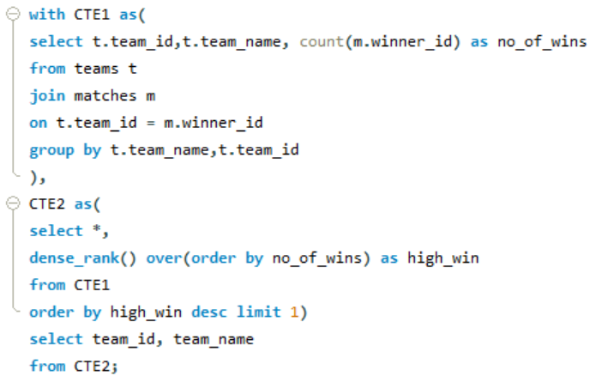

8. Which team won the most matches?

Slide 12
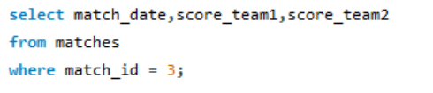

10. What is the date and the score 10. What is the date and the score of the match with match_id = 3?of the match with match_id = 3?

Slide 13

THANK YOU
This Photo by Unknown Author is licensed under CC BY-NC-ND

